Slide 1

GENERAL EXPLORATION INDUCTION
Presented by:
PREVIEW ONLY
Notes:
Welcome to CompanyABC. My name is xxxxxx and today I will be introducing you to the company and our policies and procedures that form the framework of how we conduct our selves out there in the field. The following induction is a guide of the absolute basics you must know and abide by when stepping into any exploration environment.
I have also handed out some copies of this induction. The first is a summary sheet of each topic I will discuss.
As we discuss each topic, can you please follow this and tick it off as we cover it. At the end, once we have gone over any questions, I ask that you to please sign and date the bottom of this form to state that you have been shown and understand this induction.
If you have any questions, can you please save them for the end of that segment and ask them then.

Slide 2
Ice Breaker
Hello and Welcome
PREVIEW ONLY
Notes:
Introduce yourself & your number of years in the mining & exploration industry.
Ask each member of the group to do the same.
A note to the Inductor:
There is plenty of scope for you to add to the notes and material on the slides.
Engage the audience if appropriate and if you feel comfortable. Get them to participate to help get your message across. The induction booklet follows this induction closely and provides some additional material.
Follow the slide numbers in the hand book as a guide if you have not printed the slide notes.

Slide 3
Introduction
Why ANOTHER Induction?
To introduce you to the mining & exploration industry – New People
To refresh your memory – Experienced people
To give you the basic training needed before entering a work site
To dispel confusion as to your obligations as a contractor
To equip you with the right attitude
To protect equipment and the environment
To keep you and others safe
To help you work as part of a team
PREVIEW ONLY
Notes:
So, Why ANOTHER Induction? Why are you here? – Ask this question to the audience and gauge the responses.
(Click)
To introduce you to the mining & exploration industry – New People
To refresh your memory – Experienced people
To give you the basic training needed before entering a work site
To dispel confusion as to your obligations as a contractor
To equip you with the right attitude
To protect equipment and the environment
To keep you and others safe
To help you work as part of a team
Inductions are the most effective means to ensure every person coming on to site is aware of basic rules and requirements to perform their tasks safely.
This induction is considered the minimum standard of training and education a person must undertake to start work on our company sites.

Slide 4


Company Inductions and Training
Where this induction fits in:
A number of different inductions are applicable to persons working for CompanyABC:
PREVIEW ONLY
Further Company Inductions
General Field Induction – This Induction
Office and Administration Induction
Environmental Induction – As appropriate
Other site specific Inductions – Mine site inductions
Notes:
There are several inductions that form part of the companies overall procedures. The most important and relevant ones are our General Field Induction and Office and Administration induction, as these are required by everyone before they go into the field.
(Click) - There are several other inductions you may undertake as part of your training. These include:
(Click) - Office and Administration Induction
(Click) - Environmental Induction
(Click) - Other site specific inductions – Mine site inductions
Inductions outline the important information covering health, safety, culture and environment that you should be aware of and abide by when working in the field.

Slide 5
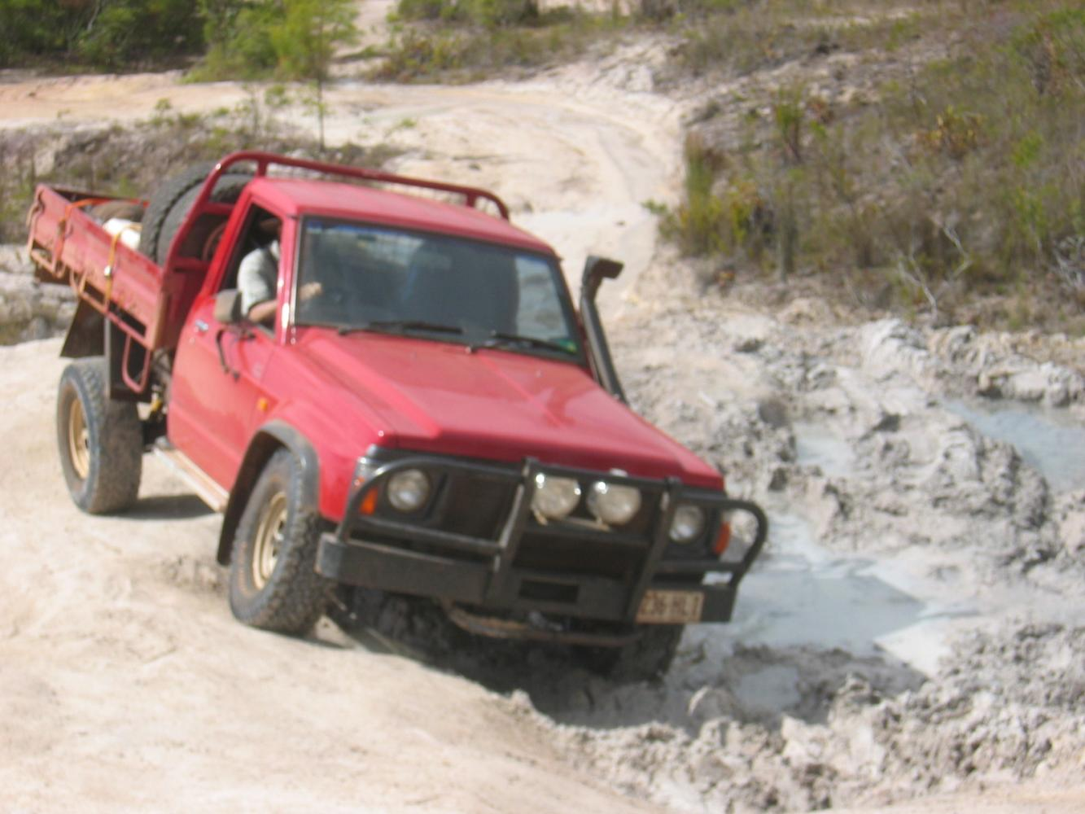
Company Inductions and Training
We also provide training for our staff in several key areas, to allow you to advance your skills, including:
Further Training
Four wheel driving
Senior First Aid
Other training as required
PREVIEW ONLY
Notes:
We also provide the following basic training to our staff:
(Click)
Four Wheel Driving & General Light Vehicle operating procedure
Senior First Aid
Drilling Practices and Procedures for Geologists
Other training as required
This is to provide you with necessary skills in the field and to advance your training and knowledge.

Slide 6
What Is Covered In This Induction
The General Field Induction Covers the Following
1. Legislative Background
2. Work Place Safety
3. Environmental Hazards
4. Personal Safety
5. Risk Assessment and Reporting
6. Project Information
1. Legislative Background
PREVIEW ONLY
6. Project Information
2. Work Place Safety
3. Environmental Hazards
5. Risk Assessment and Reporting
4. Personal Safety
Notes:
This slide summarises the content of the General Field Induction.
We will cover 6 components:
The Legislative background to safe work in the exploration and the mining industry.
Work place safety – Safety issues in the work place.
Environmental Hazards
Personal Safety
Risk Assessment and Incident Reporting
Project specific information that is important for each site

Slide 7
Legislative Background
1. Legislative Background
2. Work Place Safety
3. Environmental Hazards
4. Personal Safety
5. Risk Assessment and Reporting
6. Project Information
1. Legislative Background
PREVIEW ONLY
Notes:
Now we come to the first of our sections, legislative background.
In this part, we discuss the over all framework of the laws that govern our exploration activities and how these are translated into our everyday tasks through company policies, guidelines & procedures.

Slide 8
Legislative Background
Topics
Legislative Background
Company Policies
  Safety
    Duty of Care
  Fitness for Work
  Environmental
  Sexual Harassment & Discrimination
  Aboriginal Heritage
  Community Relations
PREVIEW ONLY
Notes:
Topics covered in this section include:
Legislative Background
Company Policies
Safety
Duty of Care
Fitness for Work
Environmental
Sexual Harassment & Discrimination
Indigenous Relations
Community Relations

